Slide 1



Data Science and Machine Learning
Generative AI Final

Slide 2

TECH PROJECT MANAGEMENT

Slide 3
Warm up What is easier to manage?
A
B
Family Dinner
Complext Tech
Project

Slide 4
Warm up How should one manage a career?
A
B
Plan everything from the start, anticipating steps and transitions
Maintain a long-term plan but iterate on next steps based on the current status

Slide 5
Warm up What superpower would you choose for project management?
A) Control time
B) Read minds
C) Clone yourself, to be in all meetings at once
D) Master influence over others

Slide 6



Need
Feature
Task
View company revenue in real-time
Weekly revenue bar chart
Build a query, perform the correct aggregation, and create the chart
Tech Project Management
6

Slide 7
Need
Feature
Task
View company revenue in real-time
Weekly revenue bar chart
Build a query, perform the correct aggregation, and create the chart
Tech Project Management
Definition of Done
7

Slide 8


Project Management diferences
Software
Real Estate
2

Slide 9
Project Management diferences
Software
Real Estate
• The product is not visible during construction, i.e., we can’t show code.
• Costs are not very visible (time, cloud services).
• To the client, iterations appear cost-free.
• Fixed costs: expenses for 1,000 or 1,000,000 users can be similar.
• Limited visibility on maintenance costs due to automation.
• The amount of work is visible during construction.
• Costs involve materials and other variables.
• Changes must be planned, and they are time-consuming and costly.
• Limited scalability and replicability.
• The project can be highly impacted by external factors.
2

Slide 10
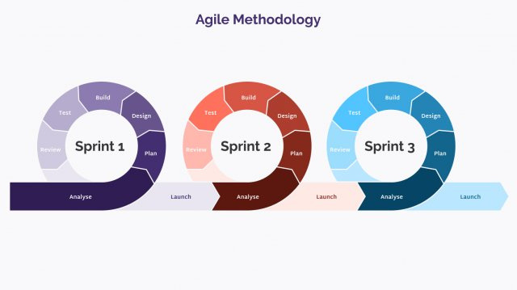
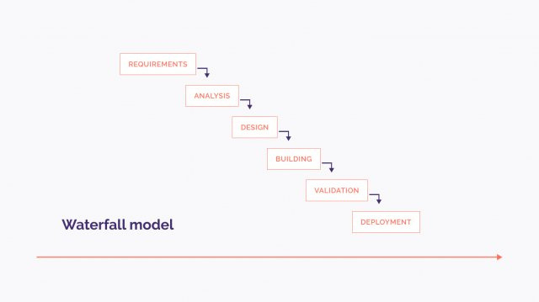
Tech project management methodologies
8

Slide 11
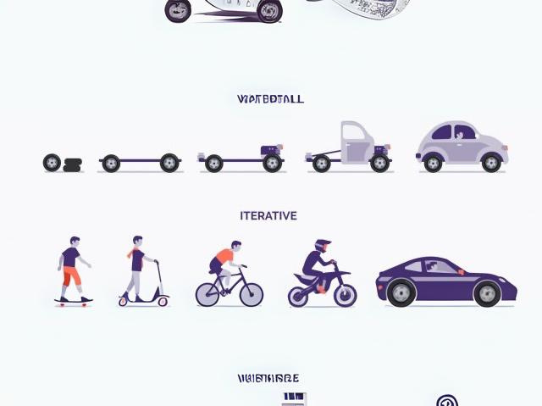
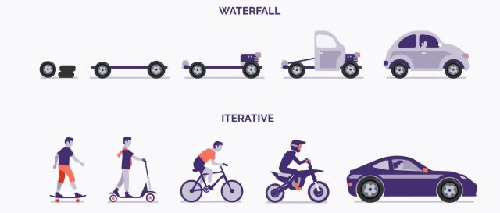
Tech project management methodologies
9

Slide 12

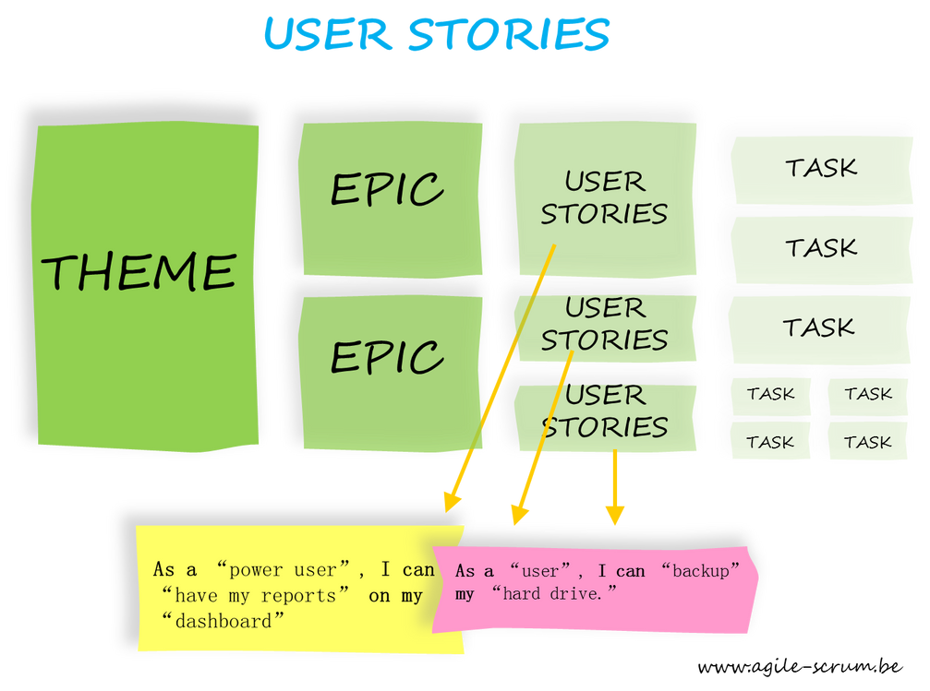
SCRUM
Tech project management methodologies
Definition of Done
Daily
Epic
Product Owner
User Stories
Sprint
Backlog
Scrum Master
Developers
11

Slide 13


Tech project management tools
What is JIRA?
Jira is a project management tool developed by Atlassian. Primarily used for software development, it allows you to plan, track, and manage the project lifecycle, especially in agile methodologies like Scrum and Kanban.
5

Slide 14
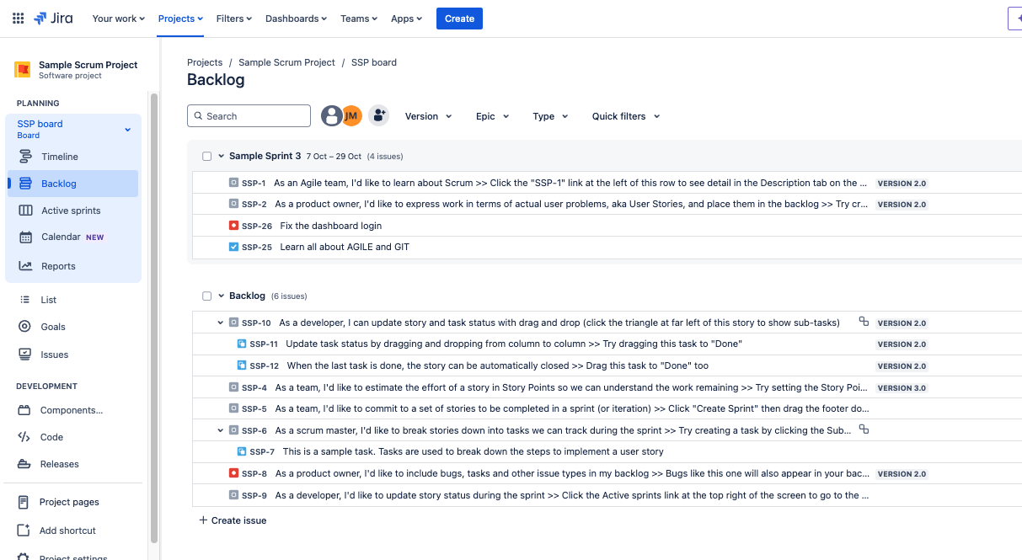
Tech project management tools
Project
A project in Jira represents a collection of tasks and functionalities that are related to a specific area of work. Each project can have its own backlog, sprint configuration, and tasks. It is the central point for managing all activities and progress within the platform.

Slide 15
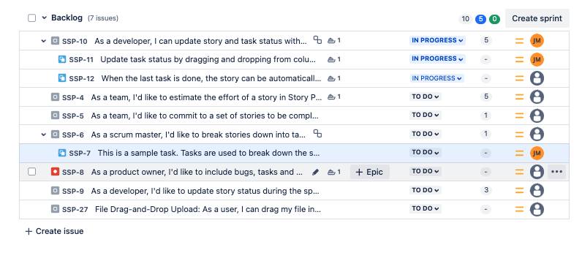
Tech project management tools
Backlog
The backlog is a prioritized list of tasks, user stories, and bugs that need to be developed. It represents the outstanding work in the project and serves as the starting point for sprint planning.

Slide 16
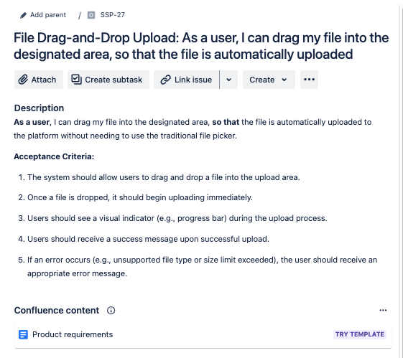
Tech project management tools
User Story
A user story in Jira represents a collection of tasks and functionalities that are related to a specific area of work. Each project can have its own backlog, sprint configuration, and tasks. It is the central point for managing all activities and progress within the platform.
5

Slide 17
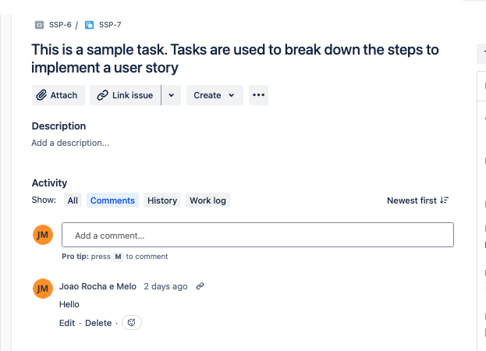
Tech project management tools
Task (Task and Subtasks)
A task is a unit of work that needs to be completed within a project. It is typically an action or a specific implementation. Subtasks are smaller divisions of a task, allowing the work to be broken down into more manageable steps.
5

Slide 18
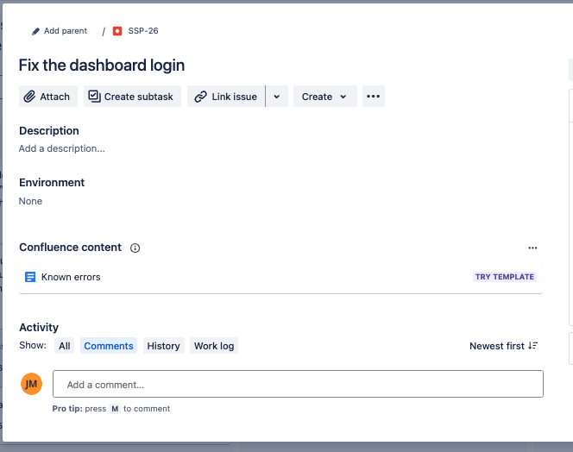
Tech project management tools
Bug
A bug in JIRA is a defect or flaw in the software that causes unexpected or incorrect behavior. It can be something that prevents a functionality from operating correctly or that leads to a poor user experience. Bugs are reported, tracked, and resolved.
5

Slide 19
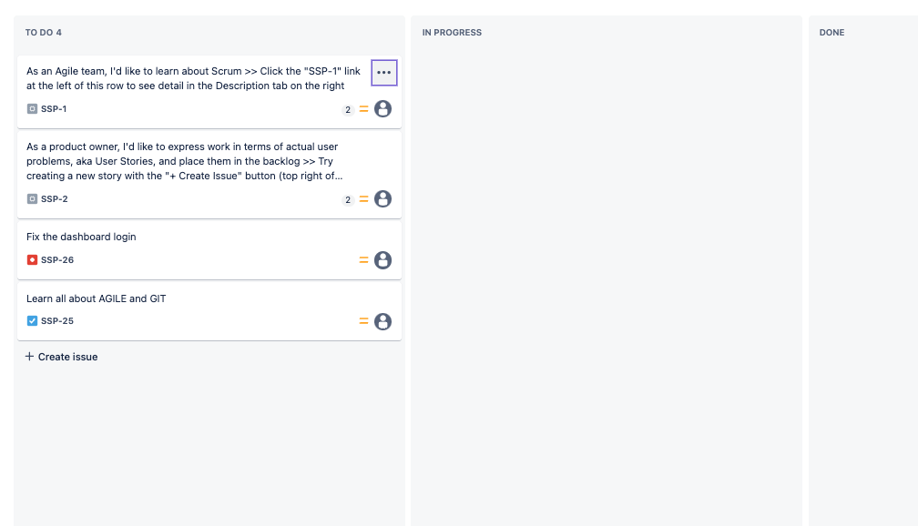
Tech project management tools
Sprint
A sprint is a time period (e.g., 1 to 4 weeks) during which a development team commits to completing a set of tasks. The goal of each sprint is to deliver a potentially usable increment of software.
5

Slide 20
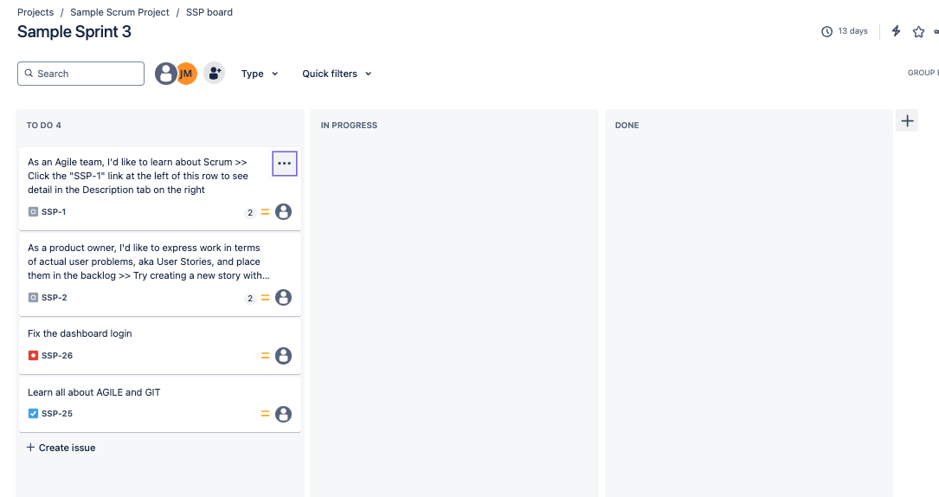
Tech project management tools
Boards
A board is a visual representation of tasks and project progress. In Jira, it can be configured as a Scrum or Kanban board. A board allows the team to see which tasks are “in progress,” “pending,” or “completed,” helping to track work effectively.

Slide 21
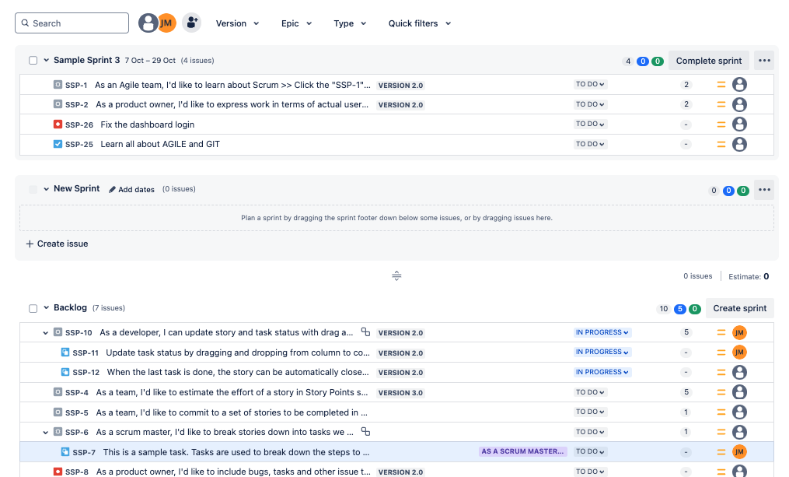
Tech project management tools
Sprint Planning
In sprint planning, the team defines which items from the backlog will be completed during the sprint. The team decides which user stories and tasks are the highest priority and align with the project’s goals for the sprint period.
5

Slide 22
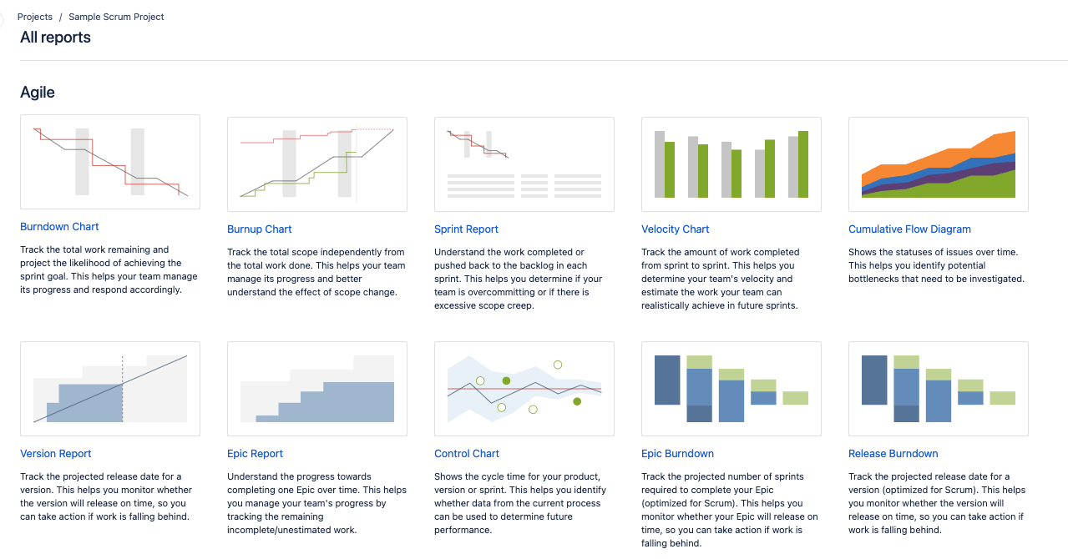
Tech project management tools
Reports
Jira offers a variety of reports that help monitor the team’s progress. Examples include velocity reports, burndown charts, and cycle reports, which provide insights into the efficiency and status of the project.
5

Slide 23
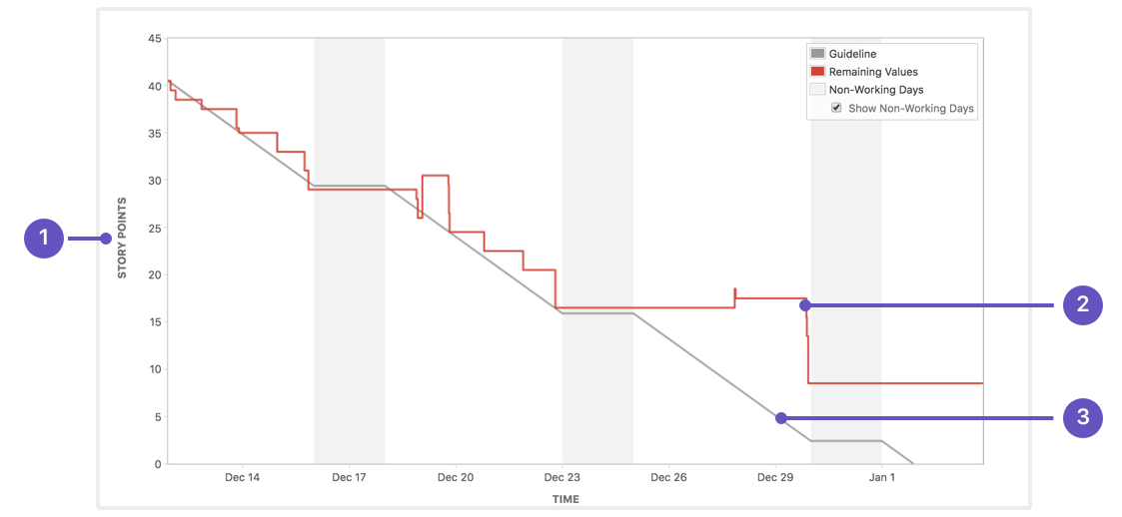
Tech project management tools
Burndown Chart
The Burndown Chart is a graphical representation that shows the amount of work remaining in a sprint or project over time. It helps the team visualize progress and adjust the pace of work to complete tasks within the sprint deadline.
5

Slide 24

Tech project management tools
Definition of Done
The Definition of Done refers to the criteria that a user story or task must meet to be considered completed. These criteria are defined by the team and may include testing, code reviews, documentation, and other requirements.

Slide 25
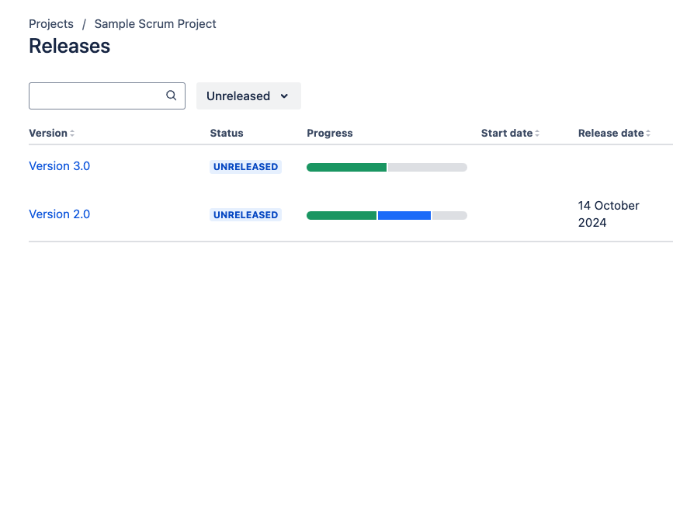
Tech project management tools
Release
A release is the act of launching a new version of the software for end users. In Jira, releases are planned over several sprints and represent significant milestones in the project’s progress.

Slide 26
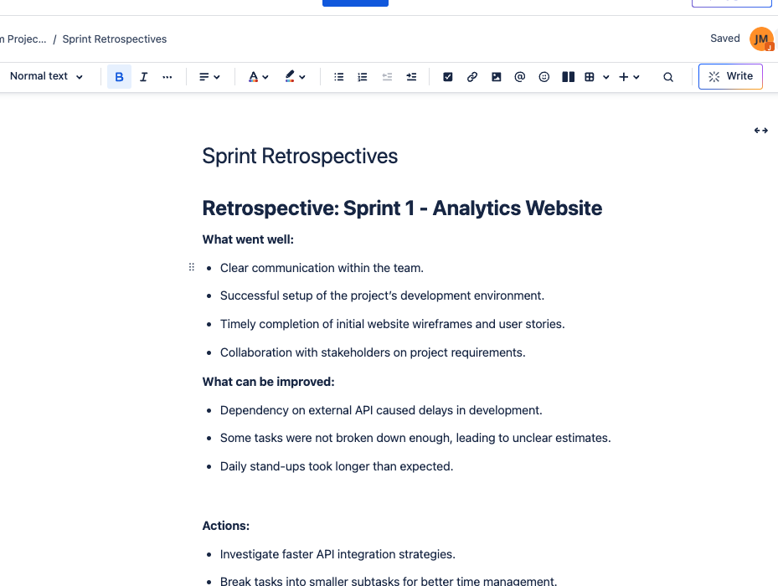
Tech project management tools
Retrospective
At the end of each sprint, the team conducts a retrospective to assess what worked well, what can be improved, and how processes can be adjusted to enhance efficiency and collaboration in the next sprint.

Slide 27
JIRA ACTIVITY

Slide 28
JIRA: Project Management
New info:
Due to delays, two tasks were not concluded (you pick two)
After reviewing, the cliente provided feedbad: they want 2 charts, not 3:
One with revenue and profit
One with costs and profit
BUG detection: filtering doesn’t work when the data is under 3 days
5

Slide 29
JIRA ACTIVITY

Slide 30
JIRA: Project
Management
SCRUM
Definition of Done
Daily
Epic
Product Owner
User Stories
Sprint
Backlog
Scrum Master
Developers

Slide 31









Tech Project Management

Slide 32
THANK YOU

